Slide 1
Chapter 3
Professional Development
Mathematics

Slide 2
Teacher Professional Development

Slide 3
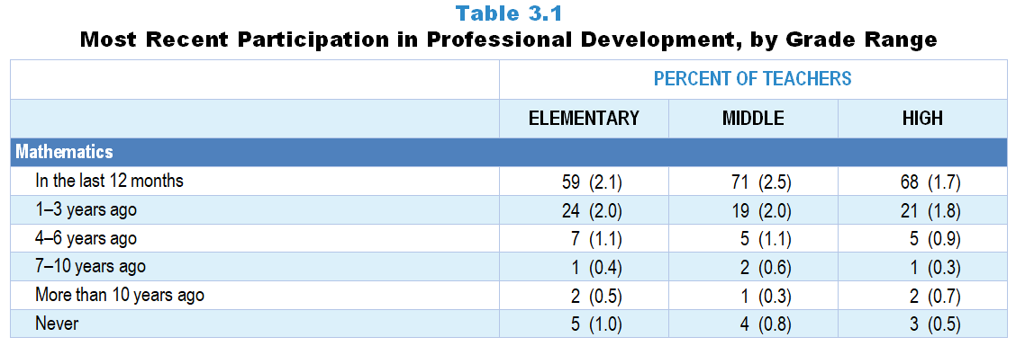
Original Data for Slide 4
(not for presentation)
Notes:
The mathematics portion of table 3.1, p. 48 in Technical Report
This slide shows data from an individual item.
Mathematics Teacher Questionnaire
Q18. When did you last participate in professional development focused on mathematics or mathematics teaching?
In the last 12 months
1-3 years ago
4–6 years ago
7–10 years ago
More than 10 years ago
Never
The numbers in parentheses are standard errors.
Findings Highlighted in Technical Report
“One important measure of teachers’ continuing education is how long it has been since they participated in professional development. As can be seen in Table 3.1, with the exception of elementary science teachers, roughly 80 percent or more of science, ‌mathematics, and ‌computer science teachers have participated in discipline-focused professional development (i.e., focused on science, mathematics, computer science content or the teaching of science, mathematics, computer science) within the last three years. Elementary science teachers stand out for the relative paucity of professional development in science or science teaching, with fewer than about 60 percent having participated in the last three years.”

Slide 4
Mathematics Teachers Participating in Mathematics-Focused Professional Development in the Last 3 Years

Slide 5
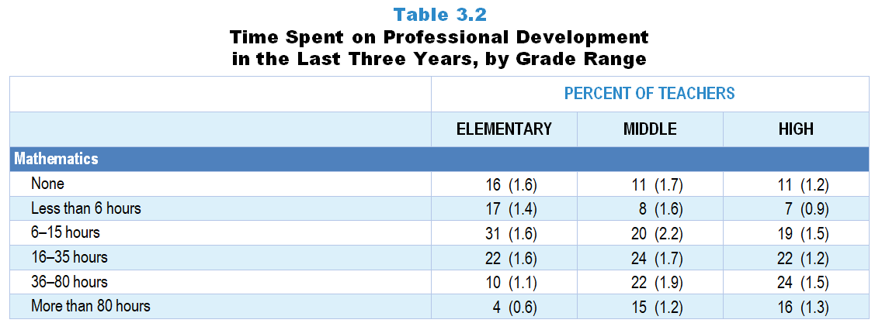
Original Data for Slide 6
(not for presentation)
Notes:
The mathematics portion of Table 3.2, p. 49 in Technical Report
This slide shows data from an individual item.
Mathematics Teacher Questionnaire
Q20. What is the total amount of time you have spent on professional development related to mathematics or mathematics teaching in the last 3 years?
Less than 6 hours
6–15 hours
16–35 hours
36–80 hours
More than 80 hours
The numbers in parentheses are standard errors.
Findings Highlighted in Technical Report
“Although some involvement in professional development may be better than none, a brief exposure of a few hours over several years is not likely to be sufficient to enhance teachers’ knowledge and skills in meaningful ways. Accordingly, teachers across all subject areas were asked about the total amount of time they have spent on discipline-focused professional development in the last three years. As can be seen in Table 3.2, about a quarter of middle school and about a third of high school science teachers have participated in 36 hours or more of science professional development in the last three years; very few elementary teachers have had this amount of professional development in science. A similar pattern exists in mathematics, with about 2 in 5 secondary teachers having participated in at least 36 hours of mathematics-focused professional development in the last three years compared to fewer than 1 in 6 elementary teachers. In contrast, over half of high school computer science teachers have participated in this amount of professional development related to computer science or computer science teaching. This finding most likely reflects the recent national emphasis on computer science in STEM education and the push to develop students’ computational thinking skills.”

Slide 6
Mathematics Teachers’ Time Spent on Mathematics-Focused Professional Development in Last 3 Years

Slide 7
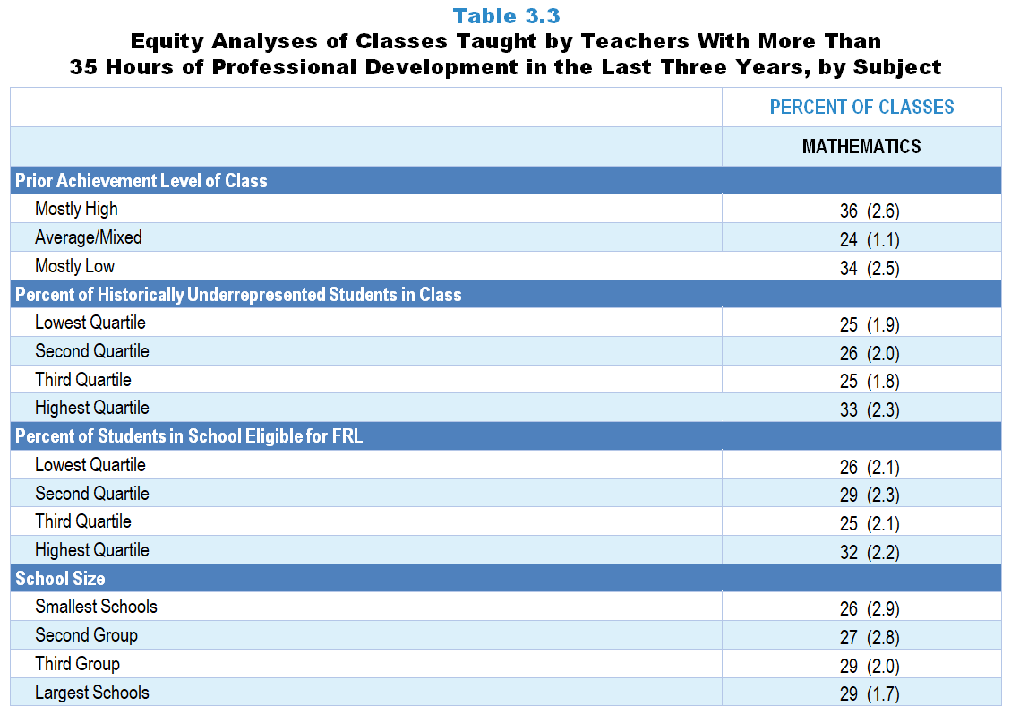
Original Data for Slide 8
(not for presentation)
Notes:
The mathematics portion of Table 3.3, p. 50 in Technical Report
This slide shows data derived from:
Mathematics Teacher Questionnaire
Q20. What is the total amount of time you have spent on professional development related to mathematics or mathematics teaching in the last 3 years?
Less than 6 hours
6–15 hours
16–35 hours
36–80 hours
More than 80 hours
Q30. For the students in this class, indicate the number of males and females in this class in each of the following categories of race/ethnicity.
American Indian or Alaskan Native _____ _____
Asian _____ _____
Black or African American _____ _____
Hispanic/Latino _____ _____
Native Hawaiian or Other Pacific Islander _____ _____
White _____ _____
Two or more races _____ _____
Q31. Which of the following best describes the prior science achievement levels of the students in this class relative to other students in this school?
Mostly low achievers
Mostly average achievers
Mostly high achievers
A mixture of levels
The numbers in parentheses are standard errors.
Chapters 2–7 in the technical report provide data on several key indicators, disaggregated by one or more equity factors: the prior achievement level of students in the class, the percentage of students from race/ethnicity groups historically underrepresented in STEM in the class, the percentage of students in the school eligible for free/reduced-price lunch (FRL), school size, community type, and region. For FRL, each school was classified into one of four categories (defined as quartiles) based on the proportion of students eligible for FRL. Similarly, each randomly selected class was classified into one of the four categories based on the proportion of students from race/ethnicity groups historically underrepresented in STEM in the class.
Findings Highlighted in Technical Report
“The data were also analyzed by a number of class and school equity factors. Table 3.3 suggests some interesting differences in the extent to which science and mathematics classes with different demographic characteristics have access to teachers who have had a substantial amount of professional development. In science, classes composed of mostly low prior achievers and classes with the highest proportion of students from race/‌ethnicity groups historically underrepresented in STEM are significantly less likely than classes of high prior achievers and few students from these race/‌ethnicity groups to be taught by teachers who have participated in more than 35 hours of professional development in the last three years. A similar disparity exists by school size. Only about half as many science classes in the smallest schools compared to classes in the largest schools have access to teachers who have participated in a substantial amount of professional development. In contrast, mathematics classes with the highest proportion of students from race/‌ethnicity groups historically underrepresented in STEM are more likely than their counterparts to be taught by teachers who have participated in more than 35 hours of professional development in the last three years. “

Slide 8
Mathematics Classes Taught by Teachers With More Than 35 Hours of Professional Development in the Last Three Years
Notes:
Historically Underrepresented Students/Teachers includes American Indian or Alaskan Native, Black or African American, Hispanic or Latino, or Native Hawaiian or Other Pacific Islander teachers/students.
Slide shows the composite scores by quartile of percent historically underrepresented students in the randomly selected class.

Slide 9
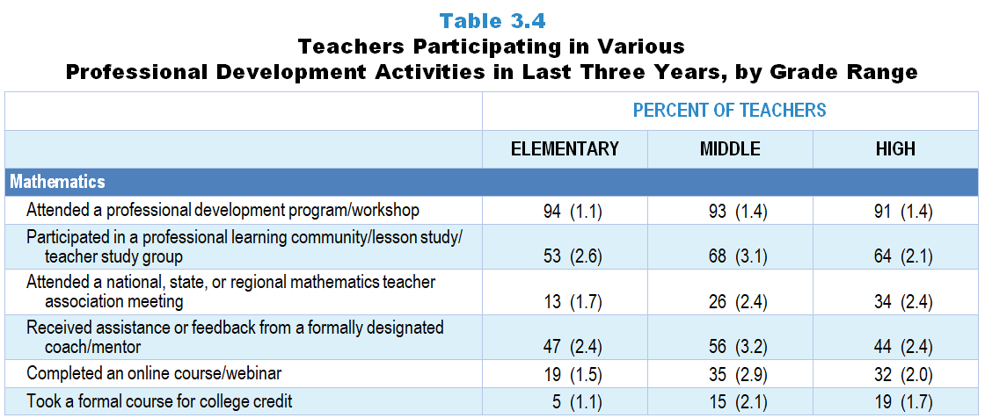
Original Data for Slides 10–12
(not for presentation)
Notes:
The mathematics portion of table 3.4, p. 51 in Technical Report
This slide shows data from individual items.
Mathematics Teacher Questionnaire
Q19. In the last 3 years, which of the following types of professional development related to mathematics or mathematics teaching have you had? [Select one on each row.] (Response Options: No, Yes)
I attended a professional development program/workshop.
I attended a national, state, or regional mathematics teacher association meeting.
I completed an online course/webinar.
I participated in a professional learning community/lesson study/teacher study group.
I received assistance or feedback from a formally designated coach/mentor.
I took a formal course for college credit.
The numbers in parentheses are standard errors.
Findings Highlighted in Technical Report
“Teachers who had recently participated in professional development were asked about the nature of those activities. Data for science, mathematics, and computer science teachers are shown in Table 3.4. For each subject/‌grade-range combination, workshops are the most prevalent activity, with roughly 90 percent of teachers indicating they have attended a program/‌workshop related to their discipline. Participation in professional learning communities is the next most prevalent activity, especially for secondary teachers (ranging from 55–68 percent of teachers). Across grade ranges, mathematics teachers are more likely to have received assistance or feedback from a formally designated coach/‌mentor than their science and computer science colleagues. Also, computer science teachers are far more likely than high school science and mathematics teachers to have completed an online course/‌webinar.”

Slide 10
Elementary Mathematics Teachers Participating in Various Professional Development Activities in Last 3 Years
Notes:
Only mathematics teachers indicating that they participated in mathematics-focused professional development in the last three years are included in these analyses.
Note: Each grade-level chart is sorted independently; consequently items may appear in different orders.

Slide 11
Middle School Mathematics Teachers Participating in Various Professional Development Activities in Last 3 Years
Notes:
Only mathematics teachers indicating that they participated in mathematics-focused professional development in the last three years are included in these analyses.
Note: Each grade-level chart is sorted independently; consequently items may appear in different orders.

Slide 12
High School Mathematics Teachers Participating in Various Professional Development Activities in Last 3 Years
Notes:
Only mathematics teachers indicating that they participated in mathematics-focused professional development in the last three years are included in these analyses.
Note: Each grade-level chart is sorted independently; consequently items may appear in different orders.

Slide 13
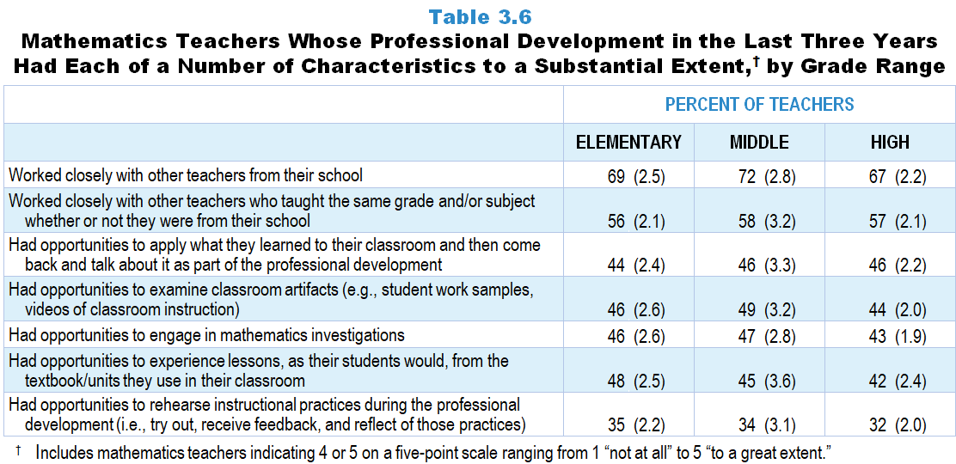
Original Data for Slides 14–16
(not for presentation)
Notes:
Table 3.6, p. 53 in Technical Report
This slide shows data from an individual item.
Mathematics Teacher Questionnaire
Q21. Considering all of your mathematics-related professional development in the last 3 years, to what extent does each of the following describe your experiences? [Select one on each row.](Response Options: [1] Not at all, [2] 2 of 5, [3] Somewhat, [4] 4 of 5, [5] To a great extent)
I had opportunities to engage in mathematics investigations.
I had opportunities to experience lessons, as my students would, from the textbook/units I use in my classroom.
I had opportunities to examine classroom artifacts (for example: student work samples, videos of classroom instruction).
I had opportunities to rehearse instructional practices during the professional development (meaning: try out, receive feedback, and reflect on those practices).
I had opportunities to apply what I learned to my classroom and then come back and talk about it as part of the professional development.
I worked closely with other teachers from my school.
I worked closely with other teachers who taught the same grade and/or subject whether or not they were from my school.
The numbers in parentheses are standard errors.
Findings Highlighted in Technical Report
“Similar to science, the most prevalent characteristic of mathematics-focused professional development is working closely with other mathematics teachers, whereas having opportunities to rehearse instructional practices during the professional development is a far less likely activity (see Table 3.6). Roughly 40–50 percent of mathematics teachers have had opportunities in their professional development to apply what they learned in their classroom and then come back and talk about it, examine classroom artifacts, engage in mathematics investigations, and experience lessons as their students would from the textbooks/‌units they use in their classroom.”

Slide 14
Elementary Mathematics Teachers Whose PD in the Last 3 Years Had Various Characteristics to a Substantial Extent
Notes:
Substantial Extent includes teachers that selected “4 of 5” or “to a great extent” on a 5-point scale with the options of “not at all,” “2 of 5,” “somewhat,” “4 of 5,” and “to a great extent.”
Only mathematics teachers indicating that they participated in mathematics-focused professional development in the last three years are included in these analyses.
Note: Each grade-level chart is sorted independently; consequently items may appear in different orders.
PD is short for professional development.

Slide 15
Middle School Mathematics Teachers Whose PD in the Last 3 Years Had Various Characteristics to a Substantial Extent
Notes:
Substantial Extent includes teachers that selected “4 of 5” or “to a great extent” on a 5-point scale with the options of “not at all,” “2 of 5,” “somewhat,” “4 of 5,” and “to a great extent.”
Only mathematics teachers indicating that they participated in mathematics-focused professional development in the last three years are included in these analyses.
Note: Each grade-level chart is sorted independently; consequently items may appear in different orders.
PD is short for professional development.

Slide 16
High School Mathematics Teachers Whose PD in the Last 3 Years Had Various Characteristics to a Substantial Extent
Notes:
Substantial Extent includes teachers that selected “4 of 5” or “to a great extent” on a 5-point scale with the options of “not at all,” “2 of 5,” “somewhat,” “4 of 5,” and “to a great extent.”
Only mathematics teachers indicating that they participated in mathematics-focused professional development in the last three years are included in these analyses.
Note: Each grade-level chart is sorted independently; consequently items may appear in different orders.
PD is short for professional development.

Slide 17
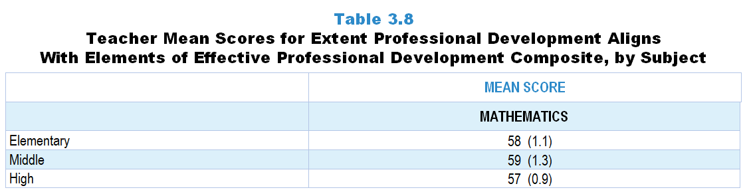
Original Data for Slide 18
(not for presentation)
Notes:
The mathematics portion of Table 3.8, p. 54 in Technical Report
This slide shows data from Composites.
Sets of related questionnaire items were combined to create several composite variables related to key constructs. Composite variables, which are more reliable than individual survey items, were computed to have a minimum possible value of 0 and a maximum possible value of 100. Higher composite scores indicate more of the construct being measure by the composite. Each composite is calculated by summing the responses to the items associated with that composite and then dividing by the total points possible. In order for the composites to be on a 100-point scale, the lowest response option on each scale was set to 0 and the others were adjusted accordingly; so for example, an item with a scale ranging from 1 to 4 was re-coded to have a scale of 0 to 3. By doing this, someone who marks the lowest point on every item in a composite receives a composite score of 0 rather than some positive number. It also assures that 50 is the true mid-point. The denominator for each composite is determined by computing the maximum possible sum of responses for a series of items and dividing by 100; e.g., a 9-item composite where each item is on a scale of 0–3 would have a denominator of 0.27. Composites values were not computed for participants who respond to fewer than two-thirds of the items that form the composite.
Extent Professional Development Aligns with Elements of Effective Professional Development
Q21a. I had opportunities to engage in mathematics investigations.
Q21b. I had opportunities to experience lessons, as my students would, from the textbook/units I use in my classroom.
Q21c. I had opportunities to examine classroom artifacts (for example: student work samples, videos of classroom instruction).
Q21d. I had opportunities to rehearse instructional practices during the professional development (meaning: try out, receive feedback, and reflect on those practices).
Q21e. I had opportunities to apply what I learned to my classroom and then come back and talk about it as part of the professional development.
Q21f. I worked closely with other teachers from my school.
Q21g. I worked closely with other teachers who taught the same grade and/or subject whether or not they were from my school.
Mathematics Teacher Questionnaire
Q21. Considering all of your mathematics-related professional development in the last 3 years, to what extent does each of the following describe your experiences? [Select one on each row.](Response Options: [1] Not at all, [2] 2 of 5, [3] Somewhat, [4] 4 of 5, [5] To a great extent)
I had opportunities to engage in mathematics investigations.
I had opportunities to experience lessons, as my students would, from the textbook/units I use in my classroom.
I had opportunities to examine classroom artifacts (for example: student work samples, videos of classroom instruction).
I had opportunities to rehearse instructional practices during the professional development (meaning: try out, receive feedback, and reflect on those practices).
I had opportunities to apply what I learned to my classroom and then come back and talk about it as part of the professional development.
I worked closely with other teachers from my school.
I worked closely with other teachers who taught the same grade and/or subject whether or not they were from my school.
The numbers in parentheses are standard errors.
Findings Highlighted in Technical Report
“As can be seen in Table 3.8, the mean scores on this composite are similar across subject/‌grade-range categories, except for elementary science, where scores are lower than the other subject/‌grade-range combinations.”

Slide 18
Extent Professional Development Aligns With Elements of Effective Professional Development Composite

Slide 19
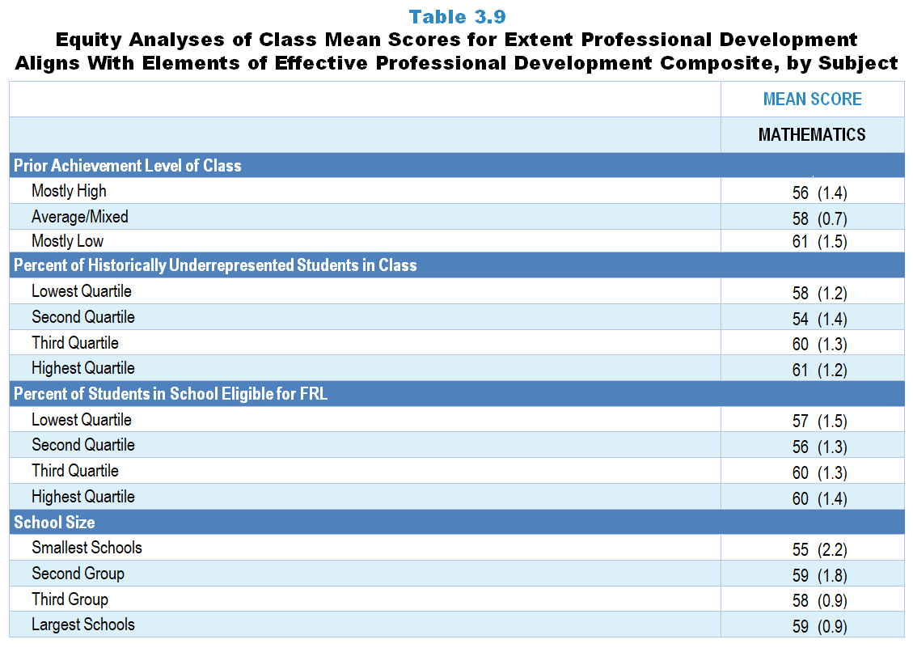
Original Data For Slide 20
(not for presentation)
Notes:
The mathematics portion of Table 3.9, p. 54 in Technical Report
This slide shows data from Composites.
Sets of related questionnaire items were combined to create several composite variables related to key constructs. Composite variables, which are more reliable than individual survey items, were computed to have a minimum possible value of 0 and a maximum possible value of 100. Higher composite scores indicate more of the construct being measure by the composite. Each composite is calculated by summing the responses to the items associated with that composite and then dividing by the total points possible. In order for the composites to be on a 100-point scale, the lowest response option on each scale was set to 0 and the others were adjusted accordingly; so for example, an item with a scale ranging from 1 to 4 was re-coded to have a scale of 0 to 3. By doing this, someone who marks the lowest point on every item in a composite receives a composite score of 0 rather than some positive number. It also assures that 50 is the true mid-point. The denominator for each composite is determined by computing the maximum possible sum of responses for a series of items and dividing by 100; e.g., a 9-item composite where each item is on a scale of 0–3 would have a denominator of 0.27. Composites values were not computed for participants who respond to fewer than two-thirds of the items that form the composite.
Extent Professional Development Aligns with Elements of Effective Professional Development
Q21a. I had opportunities to engage in mathematics investigations.
Q21b. I had opportunities to experience lessons, as my students would, from the textbook/units I use in my classroom.
Q21c. I had opportunities to examine classroom artifacts (for example: student work samples, videos of classroom instruction).
Q21d. I had opportunities to rehearse instructional practices during the professional development (meaning: try out, receive feedback, and reflect on those practices).
Q21e. I had opportunities to apply what I learned to my classroom and then come back and talk about it as part of the professional development.
Q21f. I worked closely with other teachers from my school.
Q21g. I worked closely with other teachers who taught the same grade and/or subject whether or not they were from my school.
Mathematics Teacher Questionnaire
Q21. Considering all of your mathematics-related professional development in the last 3 years, to what extent does each of the following describe your experiences? [Select one on each row.](Response Options: [1] Not at all, [2] 2 of 5, [3] Somewhat, [4] 4 of 5, [5] To a great extent)
I had opportunities to engage in mathematics investigations.
I had opportunities to experience lessons, as my students would, from the textbook/units I use in my classroom.
I had opportunities to examine classroom artifacts (for example: student work samples, videos of classroom instruction).
I had opportunities to rehearse instructional practices during the professional development (meaning: try out, receive feedback, and reflect on those practices).
I had opportunities to apply what I learned to my classroom and then come back and talk about it as part of the professional development.
I worked closely with other teachers from my school.
I worked closely with other teachers who taught the same grade and/or subject whether or not they were from my school.
Q30. For the students in this class, indicate the number of males and females in this class in each of the following categories of race/ethnicity.
American Indian or Alaskan Native _____ _____
Asian _____ _____
Black or African American _____ _____
Hispanic/Latino _____ _____
Native Hawaiian or Other Pacific Islander _____ _____
White _____ _____
Two or more races _____ _____
Q31. Which of the following best describes the prior science achievement levels of the students in this class relative to other students in this school?
Mostly low achievers
Mostly average achievers
Mostly high achievers
A mixture of levels
The numbers in parentheses are standard errors.
Chapters 2–7 in the technical report provide data on several key indicators, disaggregated by one or more equity factors: the prior achievement level of students in the class, the percentage of students from race/ethnicity groups historically underrepresented in STEM in the class, the percentage of students in the school eligible for free/reduced-price lunch (FRL), school size, community type, and region. For FRL, each school was classified into one of four categories (defined as quartiles) based on the proportion of students eligible for FRL. Similarly, each randomly selected class was classified into one of the four categories based on the proportion of students from race/ethnicity groups historically underrepresented in STEM in the class.
Findings Highlighted in Technical Report
“When looking at the composite scores by equity factors, a number of differences are apparent by both class and school factors (see Table 3.9). Science classes consisting mostly of high-achieving students are more likely than classes of mostly low-achieving students to be taught by teachers who attended high-quality professional development (mean scores of 57 and 48, respectively). A similar pattern exists in terms of school size. Science classes in the largest schools have an advantage over those in the smallest schools when it comes to having access to teachers with effective professional learning experiences (mean scores of 54 and 47, respectively).
In contrast, mathematics classes composed of mostly low-achieving students tend to be taught by teachers with more high-quality professional development experiences than classes with mostly high-achieving students (mean score 61 and 56, respectively). Also, high school computer science classes with the largest proportion of students from race/‌ethnicity groups historically underrepresented in STEM are more likely to be taught by teachers who have experienced aspects of effective professional development than classes with the smallest proportion of students from these groups (mean score of 64 and 51, respectively). However, it is important to note that for computer science, the highest quartile contains relatively few students from these groups.”

Slide 20
Extent Professional Development Aligns With Elements of Effective Professional Development Composite

Slide 21
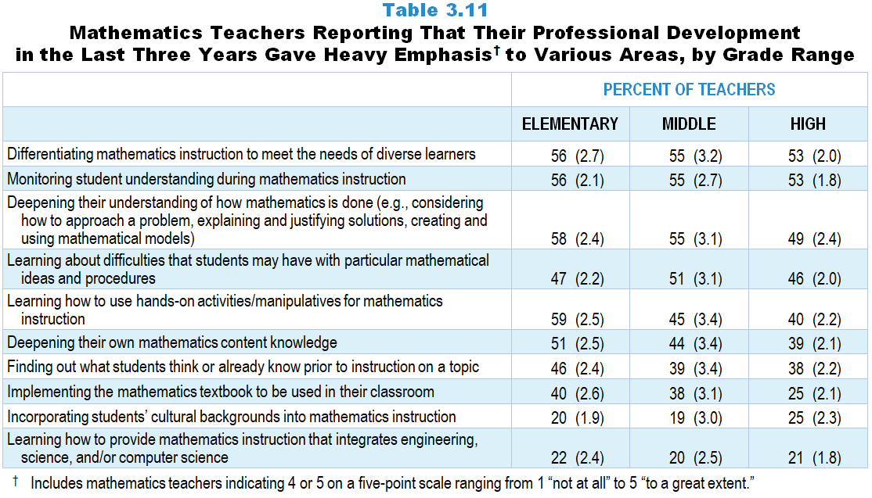
Original Data for Slides 22–27
(not for presentation)
Notes:
The mathematics portion of Table 3.11, p. 57 in Technical Report
This slide shows data from an individual item.
Mathematics Teacher Questionnaire
Q22. Thinking about all of your mathematics-related professional development in the last 3 years, to what extent was each of the following emphasized? [Select one on each row.](Response Options: [1] Not at all, [2] 2 of 5, [3] Somewhat, [4] 4 of 5, [5] To a great extent)
Deepening your own mathematics content knowledge
Deepening your understanding of how mathematics is done (for example: considering how to approach a problem, explaining and justifying solutions, creating and using mathematical models)
Implementing the mathematics textbook to be used in your classroom
Learning how to use hands-on activities/manipulatives for mathematics instruction
Learning about difficulties that students may have with particular mathematical ideas and procedures
Finding out what students think or already know prior to instruction on a topic
Monitoring student understanding during mathematics instruction
Differentiating mathematics instruction to meet the needs of diverse learners
Incorporating students’ cultural backgrounds into mathematics instruction
Learning how to provide mathematics instruction that integrates engineering, science, and/or computer science
The numbers in parentheses are standard errors.
Findings Highlighted in Technical Report
“Data for mathematics teachers are shown in Table 3.11. Similar to science, about half of mathematics teachers across the grade ranges have had professional growth opportunities in the last three years that heavily emphasized deepening understanding of how mathematics is done (49–58 percent), monitoring student understanding during mathematics instruction (53–56 percent), and differentiating mathematics instruction to meet the needs of diverse learners (53–56 percent). Another area emphasized, was learning about difficulties students may have with particular mathematics ideas and procedures (46–51 percent). Learning how to use hands-on activities/‌manipulatives for mathematics instruction was also a common focus of professional development, though more so at the elementary level than the secondary level. Only about 20 percent of teachers’ recent professional development emphasized learning how to provide mathematics instruction that integrates engineering, science, and/‌or computer science, and incorporating students’ cultural backgrounds into mathematics instruction.”

Slide 22
Elementary Mathematics Teachers Reporting PD in the Last 3 Years Gave Heavy Emphasis on Various Areas
Notes:
Heavy emphasis includes teachers that selected “4 of 5” or “to a great extent” on a 5-point scale with the options of “not at all,” “2 of 5,” “somewhat,” “4 of 5,” and “to a great extent.”
Only mathematics teachers indicating that they participated in mathematics-focused professional development in the last three years are included in these analyses.
Note: Each grade-level chart is sorted independently; consequently items may appear in different orders.
PD is short for professional development.

Slide 23
Elementary Mathematics Teachers Reporting PD in the Last 3 Years Gave Heavy Emphasis on Various Areas
Notes:
Heavy emphasis includes teachers that selected “4 of 5” or “to a great extent” on a 5-point scale with the options of “not at all,” “2 of 5,” “somewhat,” “4 of 5,” and “to a great extent.”
Only mathematics teachers indicating that they participated in mathematics-focused professional development in the last three years are included in these analyses.
Note: Each grade-level chart is sorted independently; consequently items may appear in different orders.
PD is short for professional development.

Slide 24
Middle School Mathematics Teachers Reporting PD in the Last 3 Years Gave Heavy Emphasis on Various Areas
Notes:
Heavy emphasis includes teachers that selected “4 of 5” or “to a great extent” on a 5-point scale with the options of “not at all,” “2 of 5,” “somewhat,” “4 of 5,” and “to a great extent.”
Note: Each grade-level chart is sorted independently; consequently items may appear in different orders.
PD is short for professional development.

Slide 25
Middle School Mathematics Teachers Reporting PD in the Last 3 Years Gave Heavy Emphasis on Various Areas
Notes:
Heavy emphasis includes teachers that selected “4 of 5” or “to a great extent” on a 5-point scale with the options of “not at all,” “2 of 5,” “somewhat,” “4 of 5,” and “to a great extent.”
Only mathematics teachers indicating that they participated in mathematics-focused professional development in the last three years are included in these analyses.
Note: Each grade-level chart is sorted independently; consequently items may appear in different orders.
PD is short for professional development.

Slide 26
High School Mathematics Teachers Reporting PD in the Last 3 Years Gave Heavy Emphasis on Various Areas
Notes:
Heavy emphasis includes teachers that selected “4 of 5” or “to a great extent” on a 5-point scale with the options of “not at all,” “2 of 5,” “somewhat,” “4 of 5,” and “to a great extent.”
Only mathematics teachers indicating that they participated in mathematics-focused professional development in the last three years are included in these analyses.
Note: Each grade-level chart is sorted independently; consequently items may appear in different orders.
PD is short for professional development.

Slide 27
High School Mathematics Teachers Reporting PD in the Last 3 Years Gave Heavy Emphasis on Various Areas
Notes:
Heavy emphasis includes teachers that selected “4 of 5” or “to a great extent” on a 5-point scale with the options of “not at all,” “2 of 5,” “somewhat,” “4 of 5,” and “to a great extent.”
Only mathematics teachers indicating that they participated in mathematics-focused professional development in the last three years are included in these analyses.
Note: Each grade-level chart is sorted independently; consequently items may appear in different orders.
PD is short for professional development.

Slide 28
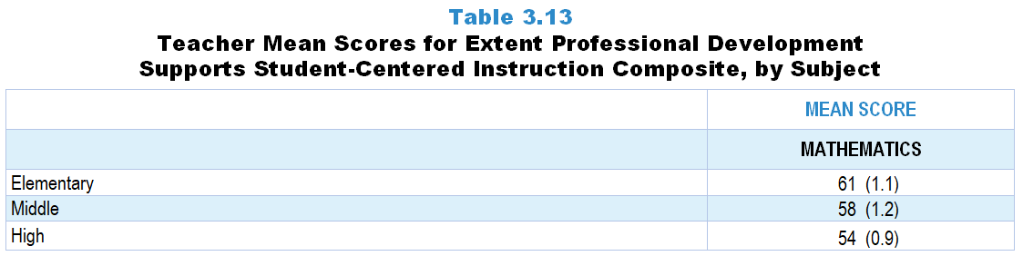
Original Data for Slide 29
(not for presentation)
Notes:
The mathematics portion of Table 3.13, p. 58 in Technical Report
This slide shows data from composites.
Sets of related questionnaire items were combined to create several composite variables related to key constructs. Composite variables, which are more reliable than individual survey items, were computed to have a minimum possible value of 0 and a maximum possible value of 100. Higher composite scores indicate more of the construct being measure by the composite. Each composite is calculated by summing the responses to the items associated with that composite and then dividing by the total points possible. In order for the composites to be on a 100-point scale, the lowest response option on each scale was set to 0 and the others were adjusted accordingly; so for example, an item with a scale ranging from 1 to 4 was re-coded to have a scale of 0 to 3. By doing this, someone who marks the lowest point on every item in a composite receives a composite score of 0 rather than some positive number. It also assures that 50 is the true mid-point. The denominator for each composite is determined by computing the maximum possible sum of responses for a series of items and dividing by 100; e.g., a 9-item composite where each item is on a scale of 0–3 would have a denominator of 0.27. Composites values were not computed for participants who respond to fewer than two-thirds of the items that form the composite.
Extent Professional Development Supports Student-Centered Instruction Composite Items
Q22a. Deepening your own mathematics content knowledge
Q22b. Deepening your understanding of how mathematics is done (for example: considering how to approach a problem, explaining and justifying solutions, creating and using mathematical models)
Q22c. Implementing the mathematics textbook to be used in your classroom
Q22d. Learning how to use hands-on activities/manipulatives for mathematics instruction
Q22e. Learning about difficulties that students may have with particular mathematical ideas and procedures
Q22f. Finding out what students think or already know prior to instruction on a topic
Q22g. Monitoring student understanding during mathematics instruction
Q22h. Differentiating mathematics instruction to meet the needs of diverse learners
Q22i. Incorporating students’ cultural backgrounds into mathematics instruction
Q22j. Learning how to provide mathematics instruction that integrates engineering, science, and/or computer science
Mathematics Teacher Questionnaire
Q22. Thinking about all of your mathematics-related professional development in the last 3 years, to what extent was each of the following emphasized? [Select one on each row.](Response Options: [1] Not at all, [2] 2 of 5, [3] Somewhat, [4] 4 of 5, [5] To a great extent)
Deepening your own mathematics content knowledge
Deepening your understanding of how mathematics is done (for example: considering how to approach a problem, explaining and justifying solutions, creating and using mathematical models)
Implementing the mathematics textbook to be used in your classroom
Learning how to use hands-on activities/manipulatives for mathematics instruction
Learning about difficulties that students may have with particular mathematical ideas and procedures
Finding out what students think or already know prior to instruction on a topic
Monitoring student understanding during mathematics instruction
Differentiating mathematics instruction to meet the needs of diverse learners
Incorporating students’ cultural backgrounds into mathematics instruction
Learning how to provide mathematics instruction that integrates engineering, science, and/or computer science
The numbers in parentheses are standard errors.
Findings Highlighted in Technical Report
“Several items related to a focus on student-centered instruction in recent teacher professional development were combined into a composite variable. As can be seen in Table 3.13, professional development for elementary mathematics is more likely than professional development for elementary science to support student-centered instruction (mean scores of 61 and 48, respectively). Interestingly, in science, professional development for middle and high school teachers gives more emphasis to student-centered instruction than elementary teachers, but in mathematics, professional development for elementary teachers is more likely to have this focus compared to what high school mathematics teachers experience. Lastly, the mean score for high school computer science teachers is significantly higher than the mean scores for both science and mathematics high school teachers.”

Slide 29
Extent Professional Development Supports Student-Centered Instruction Composite

Slide 30
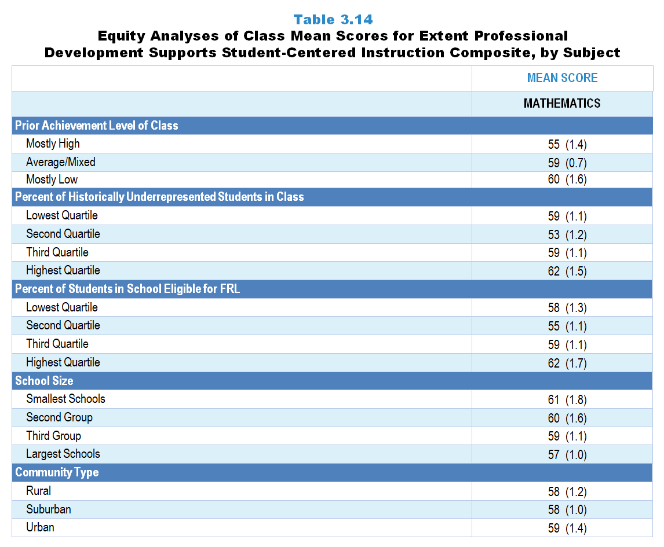
Original Data for Slide 31
(not for presentation)
Notes:
The mathematics portion of Table 3.14, p. 59 in Technical Report
This slide shows data from composites.
Sets of related questionnaire items were combined to create several composite variables related to key constructs. Composite variables, which are more reliable than individual survey items, were computed to have a minimum possible value of 0 and a maximum possible value of 100. Higher composite scores indicate more of the construct being measure by the composite. Each composite is calculated by summing the responses to the items associated with that composite and then dividing by the total points possible. In order for the composites to be on a 100-point scale, the lowest response option on each scale was set to 0 and the others were adjusted accordingly; so for example, an item with a scale ranging from 1 to 4 was re-coded to have a scale of 0 to 3. By doing this, someone who marks the lowest point on every item in a composite receives a composite score of 0 rather than some positive number. It also assures that 50 is the true mid-point. The denominator for each composite is determined by computing the maximum possible sum of responses for a series of items and dividing by 100; e.g., a 9-item composite where each item is on a scale of 0–3 would have a denominator of 0.27. Composites values were not computed for participants who respond to fewer than two-thirds of the items that form the composite.
Extent Professional Development Supports Student-Centered Instruction Composite Items
Q22a. Deepening your own mathematics content knowledge
Q22b. Deepening your understanding of how mathematics is done (for example: considering how to approach a problem, explaining and justifying solutions, creating and using mathematical models)
Q22c. Implementing the mathematics textbook to be used in your classroom
Q22d. Learning how to use hands-on activities/manipulatives for mathematics instruction
Q22e. Learning about difficulties that students may have with particular mathematical ideas and procedures
Q22f. Finding out what students think or already know prior to instruction on a topic
Q22g. Monitoring student understanding during mathematics instruction
Q22h. Differentiating mathematics instruction to meet the needs of diverse learners
Q22i. Incorporating students’ cultural backgrounds into mathematics instruction
Q22j. Learning how to provide mathematics instruction that integrates engineering, science, and/or computer science
Mathematics Teacher Questionnaire
Q22. Thinking about all of your mathematics-related professional development in the last 3 years, to what extent was each of the following emphasized? [Select one on each row.](Response Options: [1] Not at all, [2] 2 of 5, [3] Somewhat, [4] 4 of 5, [5] To a great extent)
Deepening your own mathematics content knowledge
Deepening your understanding of how mathematics is done (for example: considering how to approach a problem, explaining and justifying solutions, creating and using mathematical models)
Implementing the mathematics textbook to be used in your classroom
Learning how to use hands-on activities/manipulatives for mathematics instruction
Learning about difficulties that students may have with particular mathematical ideas and procedures
Finding out what students think or already know prior to instruction on a topic
Monitoring student understanding during mathematics instruction
Differentiating mathematics instruction to meet the needs of diverse learners
Incorporating students’ cultural backgrounds into mathematics instruction
Learning how to provide mathematics instruction that integrates engineering, science, and/or computer science
Q30. For the students in this class, indicate the number of males and females in this class in each of the following categories of race/ethnicity.
American Indian or Alaskan Native _____ _____
Asian _____ _____
Black or African American _____ _____
Hispanic/Latino _____ _____
Native Hawaiian or Other Pacific Islander _____ _____
White _____ _____
Two or more races _____ _____
Q31. Which of the following best describes the prior science achievement levels of the students in this class relative to other students in this school?
Mostly low achievers
Mostly average achievers
Mostly high achievers
A mixture of levels
The numbers in parentheses are standard errors.
Chapters 2–7 in the technical report provide data on several key indicators, disaggregated by one or more equity factors: the prior achievement level of students in the class, the percentage of students from race/ethnicity groups historically underrepresented in STEM in the class, the percentage of students in the school eligible for free/reduced-price lunch (FRL), school size, community type, and region. For FRL, each school was classified into one of four categories (defined as quartiles) based on the proportion of students eligible for FRL. Similarly, each randomly selected class was classified into one of the four categories based on the proportion of students from race/ethnicity groups historically underrepresented in STEM in the class.
Findings Highlighted in Technical Report
“Table 3.14 provides information about the extent to which science, mathematics, and computer science classes with different demographic characteristics have access to teachers who have had recent opportunities to learn about student-centered instruction. Science classes in suburban schools and those consisting of mostly high prior achievers are more likely to be taught by teachers with higher scores on this composite than classes in rural schools or those consisting of mostly low prior achievers. In mathematics, the opposite pattern is evident for prior achievement level of the class. The mean score for mathematics classes with mostly low-achieving students is 60, compared to 55 for classes with mostly high-achieving students. Surprisingly, disparities in science, mathematics, or computer science classes do not exist when the data are examined by school size, poverty level, and the percentage of students in the class from race/‌ethnicity groups historically underrepresented in STEM.”

Slide 31
Extent Professional Development Supports Student-Centered Instruction Composite

Slide 32
Professional Development Offerings at the School Level

Slide 33
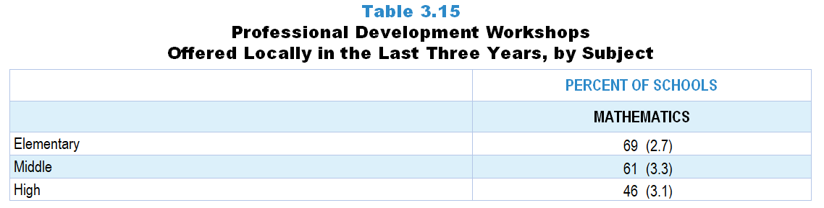
Original Data for Slide 34
(not for presentation)
Notes:
The mathematics portion of Table 3.15, p. 60 in Technical Report
This slide shows data from an individual item.
Mathematics Program Questionnaire
Q21. In the last 3 years, has your school and/or district/diocese offered workshops specifically focused on mathematics or mathematics teaching, possibly in conjunction with other organizations (for example: other schools/districts/dioceses, colleges or universities, museums, professional associations, commercial vendors)?
Yes
No
The numbers in parentheses are standard errors.
Findings Highlighted in Technical Report
“School representatives were asked whether professional development workshops in the respective discipline have been offered by their school and/‌or district, possibly in conjunction with other school systems, colleges or universities, museums, professional associations, or commercial vendors. As can be seen in Table 3.15, both elementary schools and middle schools are more likely to have locally offered workshops in mathematics than in science in the last three years. Schools across the grade levels are least likely to have local workshops in computer science.”

Slide 34
Mathematics PD Workshops Offered Locally in the Last 3 Years
Notes:
PD is short for professional development.

Slide 35
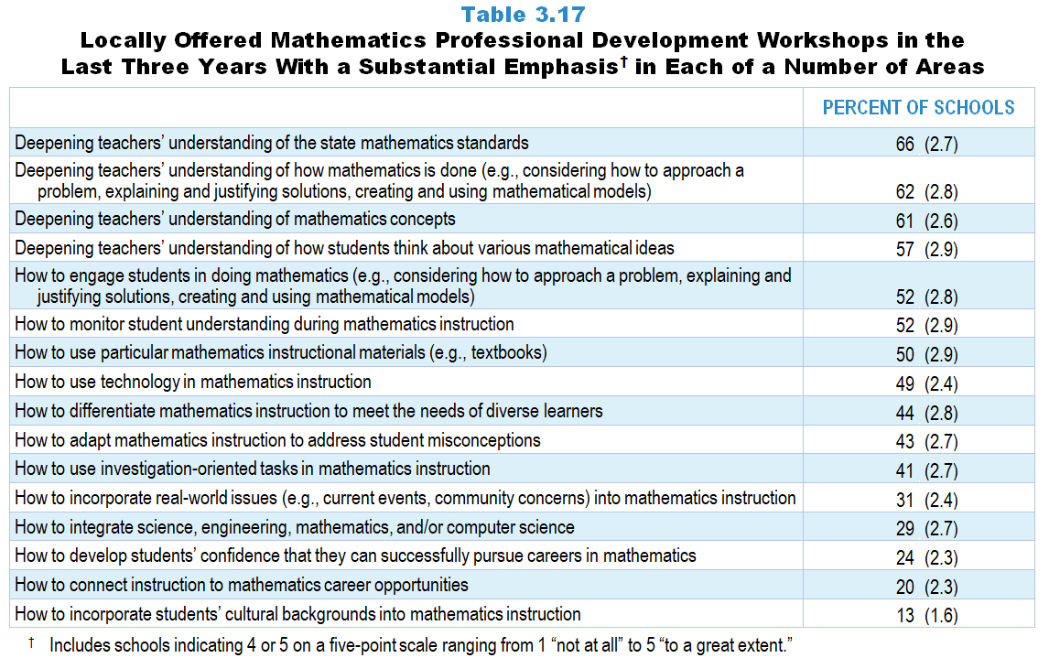
Original Data for Slides 36–38
(not for presentation)
Notes:
The mathematics portion of Table 3.17, p. 61 in Technical Report
This slide shows data from an individual item.
Mathematics Program Questionnaire
Q22. Please indicate the extent to which workshops offered by your school and/or district/diocese in the last 3 years emphasized each of the following: [Select one on each row.] (Response Options: [1] Not at all, [2] 2 of 5, [3] Somewhat, [4] 4 of 5, [5] To a great extent)
Deepening teachers’ understanding of mathematics concepts
Deepening teachers’ understanding of how mathematics is done (for example: considering how to approach a problem, explaining and justifying solutions, creating and using mathematical models)
Deepening teachers’ understanding of the state mathematics standards
Deepening teachers’ understanding of how students think about various mathematical ideas
How to use particular mathematics instructional materials (for example: textbooks)
How to monitor student understanding during mathematics instruction
How to adapt mathematics instruction to address student misconceptions
How to use technology in mathematics instruction
How to use investigation-oriented tasks in mathematics instruction
How to develop students’ confidence that they can successfully pursue careers in mathematics
How to incorporate real-world issues (for example: current events, community concerns) into mathematics instruction
How to connect instruction to mathematics career opportunities
How to integrate science, engineering, mathematics, and/or computer science
How to engage students in doing mathematics (for example: considering how to approach a problem, explaining and justifying solutions, creating and using mathematical models)
How to incorporate students’ cultural backgrounds into mathematics instruction
How to differentiate mathematics instruction to meet the needs of diverse learners
The numbers in parentheses are standard errors.
Findings Highlighted in Technical Report
“Science and mathematics program representatives who indicated that workshops have been offered locally in the last three years were asked about the extent to which that professional development emphasized each of a number of areas. In both science and mathematics, about 60 percent of schools indicated that locally offered workshops have emphasized deepening teachers’ understanding of: (1) state standards, (2) how science/‌mathematics is done, and (3) science/‌mathematics concepts (see Table 3.16 and Table 3.17). Learning how to engage students in doing science/‌mathematics, how to use particular instructional materials, and how to use technology in instruction are also relatively common emphases (45–54 percent of schools depending on subject). Relatively few locally offered workshops have focused on how to develop students’ confidence that they can successfully pursue careers in the discipline, how to connect instruction to career opportunities, and how to incorporate students’ cultural backgrounds into instruction.”

Slide 36
Locally Offered Mathematics PD Workshops in the Last 3 Years With a Substantial Focus in Various Areas
Notes:
Substantial Focus includes schools that selected “4 of 5” or “to a great extent” on a 5-point scale with the options of “not at all,” “2 of 5,” “somewhat,” “4 of 5,” and “to a great extent.”
PD is short for professional development.

Slide 37
Locally Offered Mathematics PD Workshops in the Last 3 Years With a Substantial Focus in Various Areas
Notes:
Substantial Focus includes schools that selected “4 of 5” or “to a great extent” on a 5-point scale with the options of “not at all,” “2 of 5,” “somewhat,” “4 of 5,” and “to a great extent.”
PD is short for professional development.

Slide 38
Locally Offered Mathematics PD Workshops in the Last 3 Years With a Substantial Focus in Various Areas
Notes:
Substantial Focus includes schools that selected “4 of 5” or “to a great extent” on a 5-point scale with the options of “not at all,” “2 of 5,” “somewhat,” “4 of 5,” and “to a great extent.”
PD is short for professional development.

Slide 39
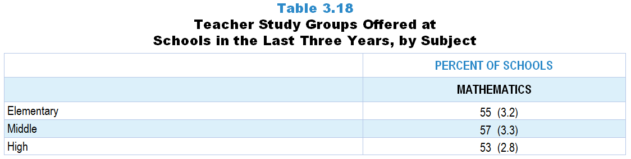
Original Data for Slide 40
(not for presentation)
Notes:
The mathematics portion of Table 3.18, p. 61 in Technical Report
This slide shows data from an individual item.
Mathematics Program Questionnaire
Q23. In the last 3 years, has your school offered teacher study groups where teachers meet on a regular basis to discuss teaching and learning of mathematics, and possibly other content areas as well (sometimes referred to as Professional Learning Communities, PLCs, or lesson study)?
Yes
No
The numbers in parentheses are standard errors.
Findings Highlighted in Technical Report
“One concern about professional development workshops is that teachers may not be given adequate assistance in applying what they are learning to their own instruction. Teacher study groups (professional learning communities, lesson study, etc.) have the potential to help teachers focus on instruction. School science, mathematics, and computer science program representatives were asked whether their school has offered teacher study groups where teachers meet on a regular basis to discuss science, mathematics, or computer science teaching and learning in the last three years. As can be seen in Table 3.18, study groups are more likely to be offered in mathematics than in science or computer science. For example, 55 percent of elementary schools offer teacher study groups in mathematics compared to only 28 percent offering them in science.”

Slide 40
Mathematics Teacher Study Groups Offered at Schools in the Last 3 Years

Slide 41
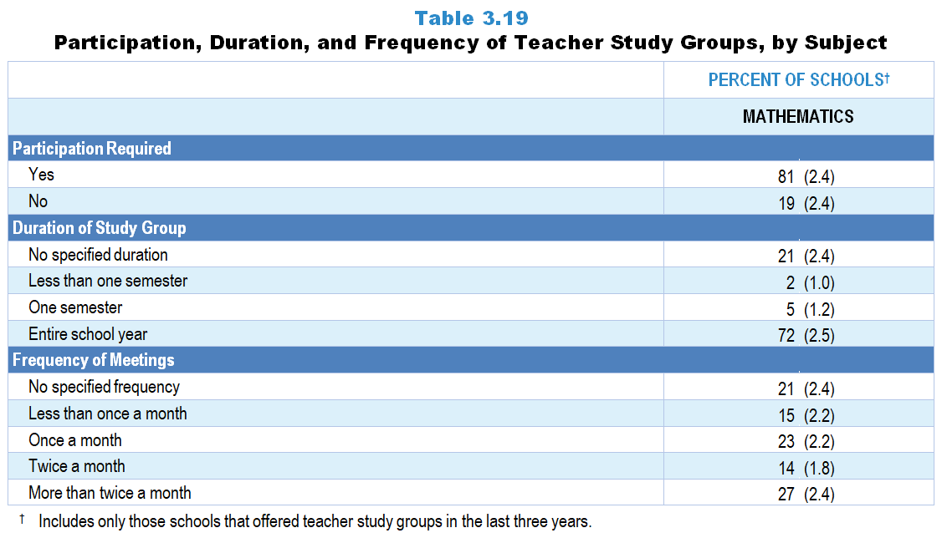
Original Data for Slide 42–44
(not for presentation)
Notes:
The mathematics portion of Table 3.19, p. 62 in Technical Report
This slide shows data from individual items.
Mathematics Program Questionnaire
Q24. [Presented only to schools that include any grades K–5] Typically, are teachers of grades K–5 mathematics required to participate in these mathematics-focused teacher study groups?
Yes, all teachers of grades K–5 mathematics
Yes, but only mathematics/STEM specialists
No
Q25. [Presented only to schools that include any grades 6–8] Typically, are teachers of grades 6–8 mathematics classes required to participate in these mathematics-focused teacher study groups?
Yes
No
Q26. [Presented only to schools that include any grades 9–12] Typically, are teachers of grades 9–12 mathematics classes required to participate in these mathematics-focused teacher study groups?
Yes
No
Q27. Has your school specified a schedule for when these mathematics-focused teacher study groups are expected to meet?
Yes
No [Skip to Q30]
Q28. Over what period of time have these mathematics-focused teacher study groups typically been expected to meet?
The entire school year
One semester
Less than one semester
Q29. How often have these mathematics-focused teacher study groups typically been expected to meet?
Less than once a month
Once a month
Twice a month
More than twice a month
The numbers in parentheses are standard errors.
Findings Highlighted in Technical Report
“Tables 3.19–3.26 present additional information provided by school program representatives about school-based teacher study groups focused on science and mathematics. As can be seen in Table 3.19, study groups in these two subjects are relatively similar in terms of whether teachers have been required to participate (78 and 81 percent). If schools do have a specified duration for the science and mathematics study groups, they tend to meet for the entire school year (55 and 72 percent, respectively), but there is considerable variation in the frequency of these study group meetings. About a quarter of schools have science and mathematics teacher study groups that meet more than twice a month.”

Slide 42
Required Participation in Mathematics Teacher Study Groups
Notes:
Includes only those schools that offered teacher study groups in the last three years.

Slide 43
Duration of Mathematics Teacher Study Groups
Notes:
Includes only those schools that offered teacher study groups in the last three years.

Slide 44
Frequency of Mathematics Teacher Study Groups
Notes:
Includes only those schools that offered teacher study groups in the last three years.

Slide 45
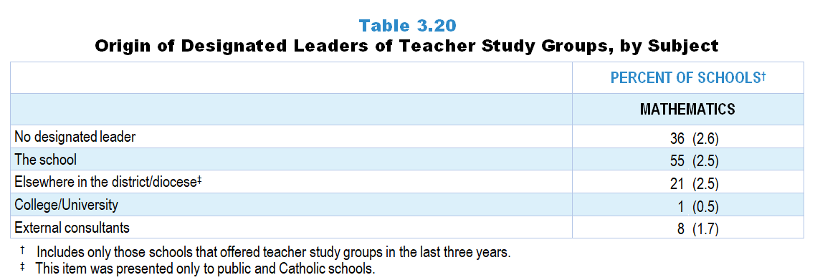
Original Data for Slide 46
(not for presentation)
Notes:
The mathematics portion of Table 3.20, p. 62 in Technical Report
This slide shows data from an individual item.
Mathematics Program Questionnaire
Q34. The designated leaders of these mathematics-focused teacher study groups were from: [Select all that apply.]
This school
Elsewhere in this district/diocese [Not presented to non-Catholic private schools]
College/University
External consultants
Other (please specify: _____)
The numbers in parentheses are standard errors.
Findings Highlighted in Technical Report
“Data about whether schools have had designated leaders for the teacher study groups and where those leaders come from are presented in Table 3.20. Roughly two-thirds of schools have had designated leaders for science and mathematics study groups, who most often come from within the school (50 and 55 percent, respectively.) “

Slide 46
Origin of Designated Leaders of Mathematics Teacher Study Groups
Notes:
Includes only those schools that offered teacher study groups in the last three year.

Slide 47
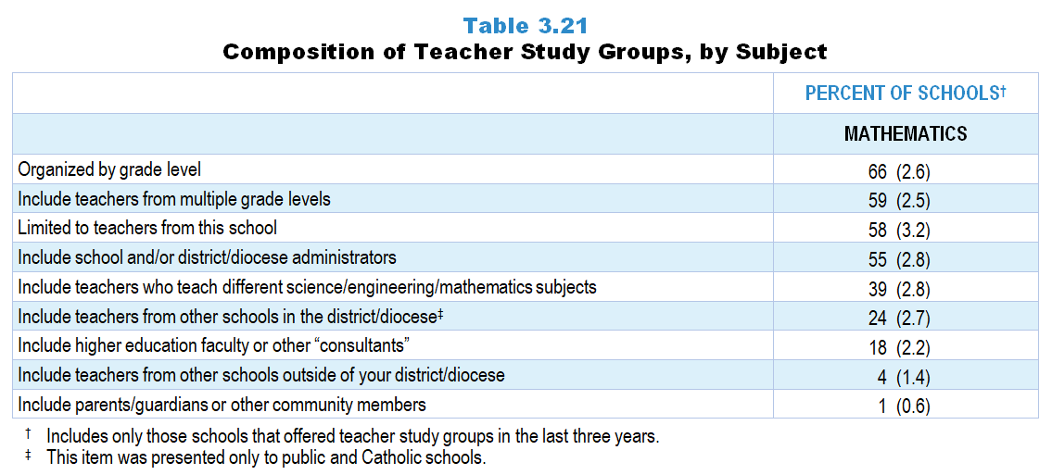
Original Data for Slide 48
(not for presentation)
Notes:
The mathematics portion of Table 3.21, p. 63 in Technical Report
This slide shows data from an individual item.
Mathematics Program Questionnaire
Q30. Which of the following describe the typical mathematics-focused teacher study groups in this school? [Select all that apply.]
Organized by grade level
Include teachers from multiple grade levels
Include teachers who teach different mathematics subjects
Include parents/guardians or other community members
Include higher education faculty or other “consultants”
Include school and/or district/diocese administrators
Limited to teachers from this school
Include teachers from other schools in the district/diocese [Not presented to non-Catholic private schools]
Include teachers from other schools outside of your district/diocese
The numbers in parentheses are standard errors.
Findings Highlighted in Technical Report
“Information about the composition of teacher study groups is shown in Table 3.21. Most schools organize their science- and mathematics-focused teacher study groups by grade level (51 and 66 percent, respectively), include teachers from multiple grade levels (63 and 59 percent), and limit participation in the study groups to teachers from their school (54 and 58 percent). Many study groups also include school and/‌or district administrators. It is rare for schools to include higher education faculty or other consultants, parents/‌guardians or other community members, or teachers from other schools outside the district in the study groups.”

Slide 48
Composition of Mathematics Teacher Study Groups
Notes:
Includes only those schools that offered teacher study groups in the last three years.

Slide 49
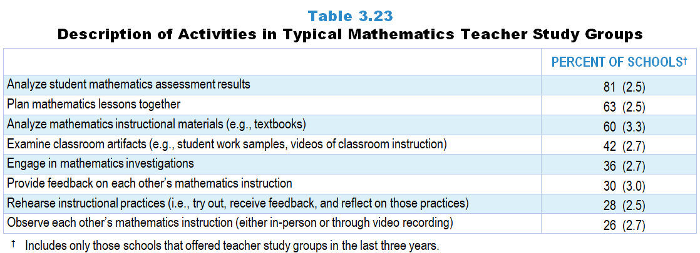
Original Data for Slide 50
(not for presentation)
Notes:
The mathematics portion of Table 3.23, p. 64 in Technical Report
This slide shows data from an individual item.
Mathematics Program Questionnaire
Q31. Which of the following describe the typical mathematics-focused teacher study groups in this school? [Select all that apply.]
Teachers engage in mathematics investigations.
Teachers analyze student mathematics assessment results.
Teachers analyze mathematics instructional materials (for example: textbooks).
Teachers plan mathematics lessons together.
Teachers rehearse instructional practices (meaning: try out, receive feedback, and reflect on those practices).
Teachers observe each other’s mathematics instruction (either in-person or through video recording).
Teachers provide feedback on each other’s mathematics instruction.
Teachers examine classroom artifacts (for example: student work samples, videos of classroom instruction).
The numbers in parentheses are standard errors.
Findings Highlighted in Technical Report
“School science and mathematics program representatives were also asked about the activities typically included in teacher study groups focused on their subject. As can be seen in Table 3.22 and Table 3.23, 65 percent of study groups in science and 81 percent in mathematics have involved teachers in analyzing student assessment results. Roughly one-half to two-thirds of study groups in each subject have had teachers plan lessons together and analyze student instructional materials. Considerably fewer study groups have had teachers provide feedback on each other’s instruction, rehearse instructional practices, and observe each other’s instruction.”

Slide 50
Description of Activities in Typical Mathematics Teacher Study Groups
Notes:
Includes only those schools that offered teacher study groups in the last three years.

Slide 51
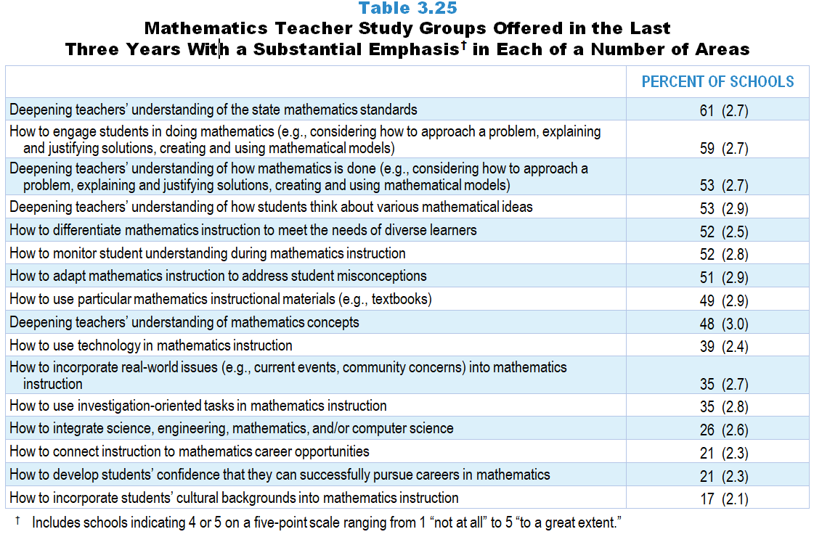
Original Data for Slides 52–54
(not for presentation)
Notes:
The mathematics portion of Table 3.25, p. 65 in Technical Report
This slide shows data from an individual item.
Mathematics Program Questionnaire
Q32. To what extent have these mathematics-focused teacher study groups emphasized each of the following? [Select one on each row.] (Response Options: [1] Not at all, [2] 2 of 5, [3] Somewhat, [4] 4 of 5, [5] To a great extent)
Deepening teachers’ understanding of mathematics concepts
Deepening teachers’ understanding of how mathematics is done (for example: considering how to approach a problem, explaining and justifying solutions, creating and using mathematical models)
Deepening teachers’ understanding of the state mathematics standards
Deepening teachers’ understanding of how students think about various mathematical ideas
How to use particular mathematics instructional materials (for example: textbooks)
How to monitor student understanding during mathematics instruction
How to adapt mathematics instruction to address student misconceptions
How to use technology in mathematics instruction
How to use investigation-oriented tasks in mathematics instruction
How to develop students’ confidence that they can successfully pursue careers in mathematics
How to incorporate real-world issues (for example: current events, community concerns) into mathematics instruction
How to connect instruction to mathematics career opportunities
How to integrate science, engineering, mathematics, and/or computer science
How to engage students in doing mathematics (for example: considering how to approach a problem, explaining and justifying solutions, creating and using mathematical models)
How to incorporate students’ cultural backgrounds into mathematics instruction
How to differentiate mathematics instruction to meet the needs of diverse learners
The numbers in parentheses are standard errors.
Findings Highlighted in Technical Report
“Further, school program representatives were asked about the extent to which the teacher study groups have addressed each of a number of topics. These data are presented in Table 3.24 and Table 3.25. Similar to the pattern seen with locally offered professional development workshops, in many schools, both science and mathematics teacher study groups in the last three years have focused heavily on deepening teachers’ understanding of the state standards (66 and 61 percent, respectively). Other areas with a substantial emphasis are learning how to engage students in doing science/‌mathematics (56 and 59 percent); deepening teachers’ understanding of how science/‌mathematics is done (46 and 53 percent); deepening teachers’ understanding of how students think about various ideas (44 and 53 percent); and monitoring student understanding during instruction (44 and 52 percent). Only about a third of schools indicated that science-focused study groups have had a large emphasis on how to engage students in doing engineering and deepening teachers’ understanding of how engineering is done.
In addition, study groups in mathematics are more likely than those in science to focus on how to differentiate instruction to meet the needs of diverse learners and how to adapt instruction to address student misconceptions. In contrast, science study groups are more likely than mathematics study groups to emphasize how to incorporate real-world issues into instruction.”

Slide 52
Emphases of Typical Mathematics Teacher Study Groups
Notes:
Note: Includes schools indicating 4 or 5 on a five-point scale ranging from 1 “not at all” to 5 “to a great extent.”
Includes only those schools that offered teacher study groups in the last three years.

Slide 53
Emphases of Typical Mathematics Teacher Study Groups
Notes:
Note: Includes schools indicating 4 or 5 on a five-point scale ranging from 1 “not at all” to 5 “to a great extent.”
Includes only those schools that offered teacher study groups in the last three years.

Slide 54
Emphases of Typical Mathematics Teacher Study Groups
Notes:
Note: Includes schools indicating 4 or 5 on a five-point scale ranging from 1 “not at all” to 5 “to a great extent.”
Includes only those schools that offered teacher study groups in the last three years.

Slide 55
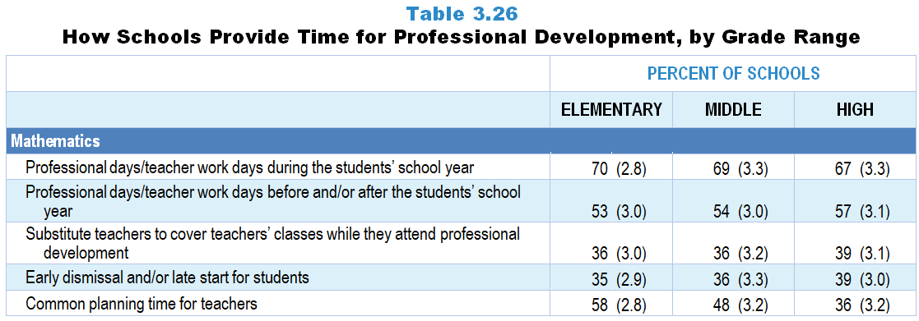
Original Data for Slides 56–58
(not for presentation)
Notes:
The mathematics portion of Table 3.26, p. 66 in Technical Report
This slide shows data from an individual item.
Mathematics Program Questionnaire
Q35. Thinking about last school year, which of the following were used to provide teachers in this school with time for professional development workshops/teacher study groups that included a focus on mathematics and/or mathematics teaching, regardless of whether they were offered by your school and/or district/diocese? [Select all that apply.]
Early dismissal and/or late start for students
Professional days/teacher work days during the students' school year
Professional days/teacher work days before and/or after the students' school year
Common planning time for teachers
Substitute teachers to cover teachers' classes while they attend professional development
None of the above
The numbers in parentheses are standard errors.
Findings Highlighted in Technical Report
“Although there is general agreement that teachers can benefit from participating in professional development workshops and study groups, it is often difficult to find time for them to do so. School representatives were given a list of ways in which time might be provided for teachers to participate in professional development, regardless of whether it is offered by the school, and asked to indicate which are used in their school. As can be seen in Table 3.26, roughly half of schools use teacher work days during the school year for science-related professional development; over two-thirds do so for mathematics-related professional development. It is less common for schools to use substitute teachers or early dismissal/‌late start for students as a means to provide time for professional development in science and mathematics. In mathematics, more schools at the elementary and middle level provide common planning time for professional development than schools at the high school level (58, 48, and 36 percent, respectively).”

Slide 56
How Elementary Schools Provide Time for Mathematics Professional Development
Notes:
Note: Each grade-level chart is sorted independently; consequently items may appear in different orders.

Slide 57
How Middle Schools Provide Time for Mathematics Professional Development
Notes:
Note: Each grade-level chart is sorted independently; consequently items may appear in different orders.

Slide 58
How High Schools Provide Time for Mathematics Professional Development
Notes:
Note: Each grade-level chart is sorted independently; consequently items may appear in different orders.

Slide 59
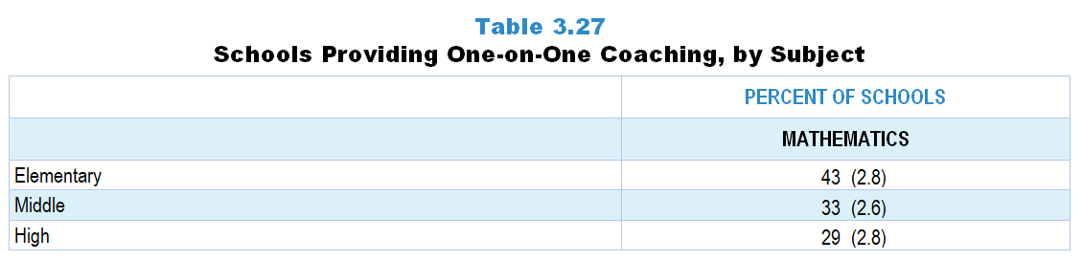
Original Data for Slide 60
(not for presentation)
Notes:
The mathematics portion of Table 3.27, p. 67 in Technical Report
This slide shows data from an individual item.
Mathematics Program Questionnaire
Q36. Do any teachers in your school have access to one-on-one coaching focused on improving their mathematics instruction (include voluntary and required coaching)?
Yes
No
The numbers in parentheses are standard errors.
Findings Highlighted in Technical Report
“As noted earlier, professional development workshops and teacher study groups can provide important opportunities for teachers to deepen their disciplinary and pedagogical content knowledge, and to develop skill in using that knowledge for key tasks of teaching, such as analyzing student work to determine what a student does and does not understand. When resources allow, one-on-one coaching to help teachers improve their practice can be a powerful tool.
School program representatives were asked whether any teachers in their school have access to one-on-one coaching focused on improving their science, mathematics, and ‌computer science instruction; these data are shown in Table 3.27. Across subject areas and grade ranges, one-on-one coaching is relatively rare except in elementary school mathematics, where over 4 in 10 schools offer coaching.”

Slide 60
Schools Providing One-on-One Mathematics Coaching

Slide 61
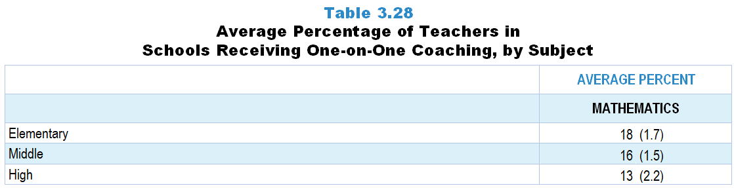
Original Data for Slide 62
(not for presentation)
Notes:
The mathematics portion of Table 3.28, p. 67 in Technical Report
This slide shows data from an individual item.
Mathematics Program Questionnaire
Q37. This school year, how many teachers in this school have received one-on-one coaching focused on improving their mathematics instruction (include voluntary and required coaching)? _____
The numbers in parentheses are standard errors.
Findings Highlighted in Technical Report
“Not only is one-on-one coaching a somewhat uncommon practice, but the proportion of teachers who are coached is small. In science, roughly 10 percent of teachers in schools are provided with one-on-one coaching (see Table 3.28). The proportion of teachers receiving coaching in mathematics ranges from 13–18 percent depending on grade range. “

Slide 62
Average Percentage of Teachers in Schools Receiving One-on-One Mathematics Coaching

Slide 63
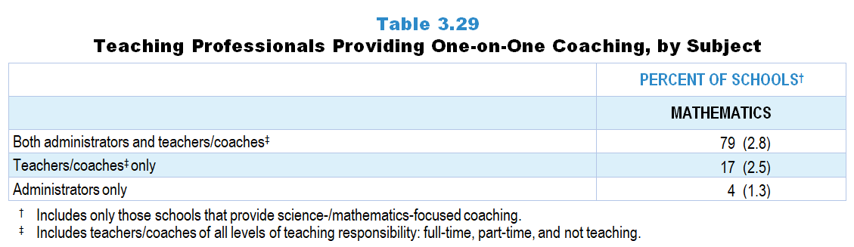
Original Data for Slide 64
(not for presentation)
Notes:
The mathematics portion of Table 3.29, p. 67 in Technical Report
This slide shows data derived from:
Mathematics Program Questionnaire
Q38. To what extent is one-on-one coaching focused on improving mathematics instruction provided by each of the following? [Select one on each row.] (Response Options: [1] Not at all, [2] 2 of 5, [3] Somewhat, [4] 4 of 5, [5] To a great extent)
The principal of your school
An assistant principal at your school
District/Diocese administrators including mathematics supervisors/ coordinators [Not presented to non-Catholic private schools]
Teachers/coaches who do not have classroom teaching responsibilities
Teachers/coaches who have part-time classroom teaching responsibilities
Teachers/coaches who have full-time classroom teaching responsibilities
The numbers in parentheses are standard errors.
Findings Highlighted in Technical Report
“In schools where science/‌mathematics teachers have access to one-on-one coaching, program representatives were asked who provides the coaching services. Roughly three-quarters of schools that offer coaching use a combination of administrators and teachers/‌coaches (see Table 3.29).”

Slide 64
Teaching Professionals Providing Mathematics-Focused One-on-One Coaching
Notes:
Includes only those schools that provide mathematics-focused coaching.
Includes teachers/coaches of all levels of teaching responsibility: full-time, part-time, and not teaching.

Slide 65
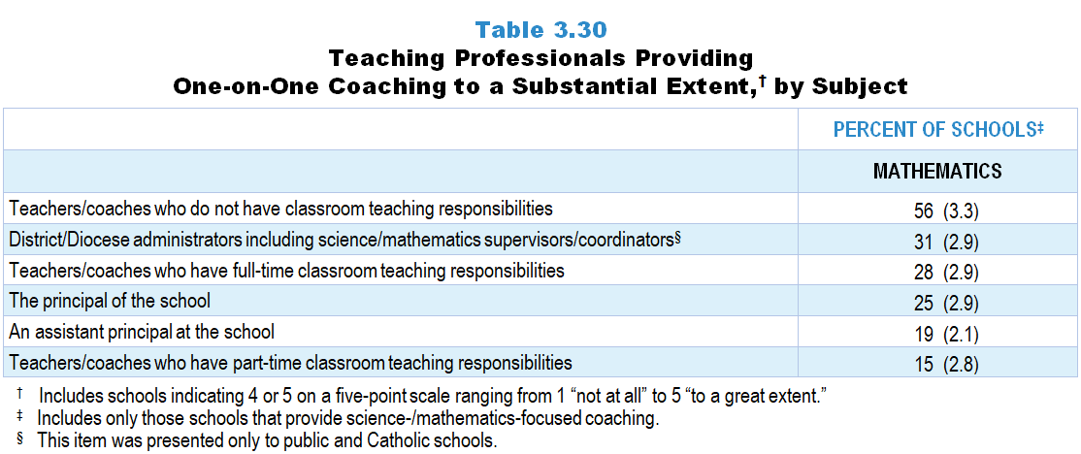
Original Data for Slide 66
(not for presentation)
Notes:
The mathematics portion of Table 3.30, p. 68 in Technical Report
This slide shows data from an individual item.
Mathematics Program Questionnaire
Q38. To what extent is one-on-one coaching focused on improving mathematics instruction provided by each of the following? (Response Options: [1] Not at all, [2] 2 of 5, [3] Somewhat, [4] 4 of 5, [5] To a great extent)
The principal of your school
An assistant principal at your school
District/Diocese administrators including mathematics supervisors/ coordinators [Not presented to non-Catholic private schools]
Teachers/coaches who do not have classroom teaching responsibilities
Teachers/coaches who have part-time classroom teaching responsibilities
Teachers/coaches who have full-time classroom teaching responsibilities
The numbers in parentheses are standard errors.
Findings Highlighted in Technical Report
“Although most schools have both teachers/‌coaches and administrators provide coaching, it appears that teachers/‌coaches are responsible for the bulk of it. Table 3.30 shows the percentage of schools with coaching provided by different professionals to a substantial extent. In science, 40 percent of schools have teachers/‌coaches who have full-time teaching loads provide one-on-one coaching to a substantial extent; 37 percent use teachers/‌coaches who do not have classroom teaching responsibilities. Fifty-six percent of schools have one-on-one mathematics coaching provided to a substantial extent by teachers/‌coaches who do not have classroom teaching responsibilities; 28 percent use teachers/‌coaches with full class loads to a substantial extent.”

Slide 66
Professionals Providing Mathematics- Focused One-on-One Coaching to a Substantial Extent
Notes:
Substantial Extent includes schools that selected “4 of 5” or “to a great extent” on a 5-point scale with the options of “not at all,” “2 of 5,” “somewhat,” “4 of 5,” and “to a great extent.”
Includes only those schools that provide mathematics-focused coaching.

Slide 67
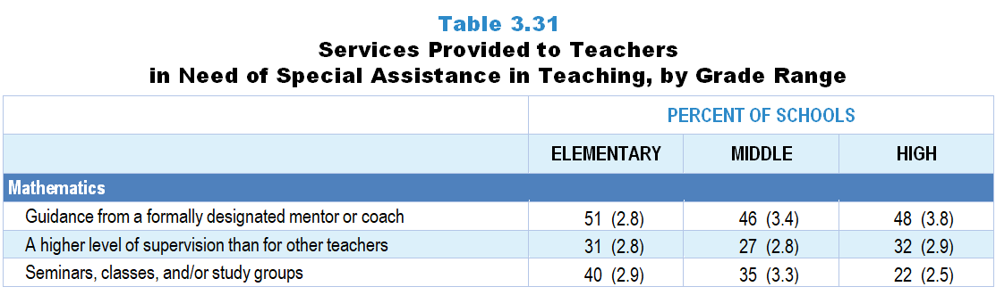
Original Data for Slide 68
(not for presentation)
Notes:
The mathematics portion of Table 3.31, p. 68 in Technical Report
This slide shows data from an individual item.
Mathematics Program Questionnaire
Q39. Which of the following are provided to teachers considered in need of special assistance in mathematics teaching? [Select all that apply.]
Seminars, classes, and/or study groups
Guidance from a formally designated mentor or coach
A higher level of supervision than for other teachers
None of the above
The numbers in parentheses are standard errors.
Findings Highlighted in Technical Report
“In addition, school science and mathematics program representatives were asked about the services provided to teachers in need of special assistance. In science, 33–44 percent of schools, depending on grades served, provide guidance from a formally designated mentor or coach (see Table 3.31). The likelihood of schools providing a higher level of supervision for these teachers increases as grade level increases. In mathematics, about half of the schools at each grade range have mentors or coaches who provide guidance to teachers in particular need of help. Schools that include elementary grades are more likely than schools at the high school level to provide seminars, classes, and/‌or study groups for these teachers (40 vs. 22 percent, respectively).”

Slide 68
Services Provided to Mathematics Teachers in Need of Special Assistance in Teaching

Slide 69
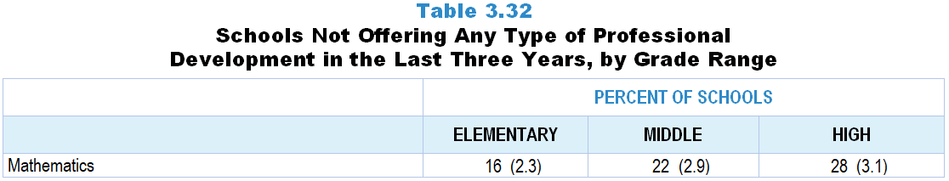
Original Data for Slide 70
(not for presentation)
Notes:
The mathematics portion of Table 3.32, p. 69 in Technical Report
This slide shows data derived from:
Mathematics Program Questionnaire
Q21. In the last 3 years, has your school and/or district/diocese offered workshops specifically focused on mathematics or mathematics teaching, possibly in conjunction with other organizations (for example: other schools/districts/dioceses, colleges or universities, museums, professional associations, commercial vendors)?
Yes
No
Q23. In the last 3 years, has your school offered teacher study groups where teachers meet on a regular basis to discuss teaching and learning of mathematics, and possibly other content areas as well (sometimes referred to as Professional Learning Communities, PLCs, or lesson study)?
Yes
No
Q36. Do any teachers in your school have access to one-on-one coaching focused on improving their mathematics instruction (include voluntary and required coaching)?
Yes
No
The numbers in parentheses are standard errors.
Findings Highlighted in Technical Report
“Responses to whether schools/‌districts provide science, mathematics, and ‌computer science workshops, teacher study groups, and one-on-one coaching were combined to look at the proportion of schools that have not offered any of these types of professional development. As can be seen in Table 3.32, about a third of schools have not offered some form of professional development in science in the last three years; 16–28 percent of schools, depending on grade level, have not offered any type of professional development in mathematics. In contrast, about 40–50 percent of schools have not offered computer science professional development at all in the last three years.”

Slide 70
Schools Not Offering Any Type of Mathematics Professional Development in the Last 3 Years

Slide 71
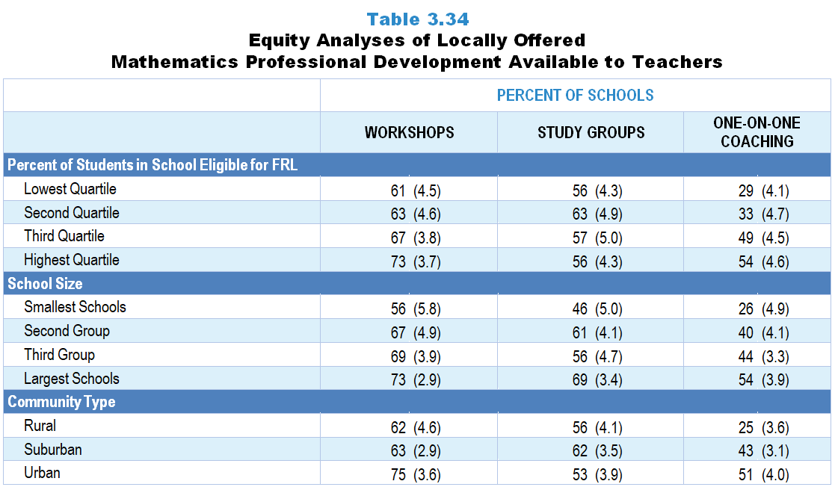
Original Data for Slides 72–74
(not for presentation)
Notes:
The mathematics portion of Table 3.34, p. 70 in Technical Report
This slide shows data derived from:
Mathematics Program Questionnaire
Q21. In the last 3 years, has your school and/or district/diocese offered workshops specifically focused on mathematics or mathematics teaching, possibly in conjunction with other organizations (for example: other schools/districts/dioceses, colleges or universities, museums, professional associations, commercial vendors)?
Yes
No
Q23. In the last 3 years, has your school offered teacher study groups where teachers meet on a regular basis to discuss teaching and learning of mathematics, and possibly other content areas as well (sometimes referred to as Professional Learning Communities, PLCs, or lesson study)?
Yes
No
Q36. Do any teachers in your school have access to one-on-one coaching focused on improving their mathematics instruction (include voluntary and required coaching)?
Yes
No
The numbers in parentheses are standard errors.
Chapters 2–7 in the technical report provide data on several key indicators, disaggregated by one or more equity factors: the prior achievement level of students in the class, the percentage of students from race/ethnicity groups historically underrepresented in STEM in the class, the percentage of students in the school eligible for free/reduced-price lunch (FRL), school size, community type, and region. For FRL, each school was classified into one of four categories (defined as quartiles) based on the proportion of students eligible for FRL. Similarly, each randomly selected class was classified into one of the four categories based on the proportion of students from race/ethnicity groups historically underrepresented in STEM in the class.
Findings Highlighted in Technical Report
“Table 3.34 shows data for mathematics. The largest schools are substantially more likely than the smallest schools to offer each of these professional development services. Schools with the largest proportion of students eligible for free/‌reduced-price lunch are more likely than those in the lowest quartile to offer mathematics-focused one-on-one coaching. As is the case in science, schools in rural areas are less likely than urban schools to offer workshops and one-on-one coaching in mathematics.”

Slide 72
Locally Offered Mathematics Professional Development Available to Teachers, by Percentage of Students in School Eligible for FRL
Notes:
Slide shows the composite scores by quartile of percent free/reduced-price lunch eligible students in the school.

Slide 73
Locally Offered Mathematics Professional Development Available to Teachers, by School Size

Slide 74
Locally Offered Mathematics Professional Development Available to Teachers, by Community Type

